Slide 1





Get Connected with your Local Salesforce Platform Developer User Group
Andy Boettcher, Demand Chain Systems, Senior CRM Advisor
Twin Cities Salesforce Developer User Group Leader
@andyboettcher
in/andyboettcher
andyboettcher.com

Slide 2
Safe harbor
Safe harbor statement under the Private Securities Litigation Reform Act of 1995:
This presentation may contain forward-looking statements that involve risks, uncertainties, and assumptions. If any such uncertainties materialize or if any of the assumptions proves incorrect, the results of salesforce.com, inc. could differ materially from the results expressed or implied by the forward-looking statements we make. All statements other than statements of historical fact could be deemed forward-looking, including any projections of product or service availability, subscriber growth, earnings, revenues, or other financial items and any statements regarding strategies or plans of management for future operations, statements of belief, any statements concerning new, planned, or upgraded services or technology developments and customer contracts or use of our services.
The risks and uncertainties referred to above include – but are not limited to – risks associated with developing and delivering new functionality for our service, new products and services, our new business model, our past operating losses, possible fluctuations in our operating results and rate of growth, interruptions or delays in our Web hosting, breach of our security measures, the outcome of intellectual property and other litigation, risks associated with possible mergers and acquisitions, the immature market in which we operate, our relatively limited operating history, our ability to expand, retain, and motivate our employees and manage our growth, new releases of our service and successful customer deployment, our limited history reselling non-salesforce.com products, and utilization and selling to larger enterprise customers. Further information on potential factors that could affect the financial results of salesforce.com, inc. is included in our annual report on Form 10-Q for the most recent fiscal quarter ended July 31, 2012. This documents and others containing important disclosures are available on the SEC Filings section of the Investor Information section of our Web site.
Any unreleased services or features referenced in this or other presentations, press releases or public statements are not currently available and may not be delivered on time or at all. Customers who purchase our services should make the purchase decisions based upon features that are currently available. Salesforce.com, inc. assumes no obligation and does not intend to update these forward-looking statements.

Slide 3
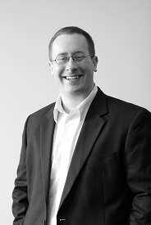
Andy Boettcher
Senior CRM Advisor, Demand Chain Systems
Twin Cities Developer Group Leader
@andyboettcher

Slide 4

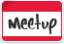
Twin Cities Developer Group
The Minneapolis / St. Paul (MN) developer user group for salesforce.com, force.com, and other force-related technical topics
http://www.meetup.com/SFTCDUG
@tc_dug
Since January 2012
~175 members
30-50 members at meetings

Slide 5
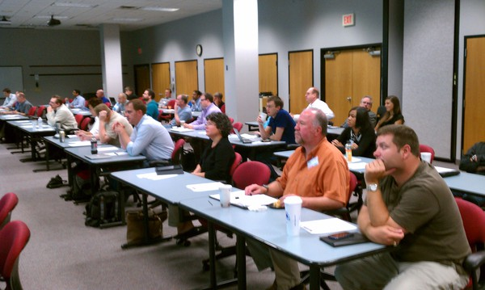
What is a Developer User Group?
Gathering of peers
Different ideas
Different perspectives
Just…different people!
Sharing of ideas and tips / tricks
Not a single one of us is smarter than all of us!

Slide 6
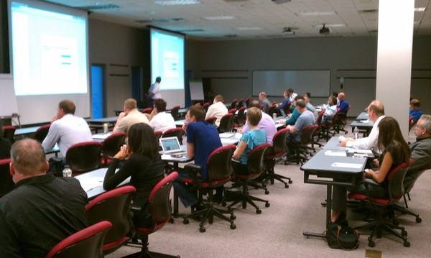
What do we do?
Connect and network
Ask questions of each other
Find answers for each other
Meet 8-10x per year
General meetings, focus sessions, social setting
Happy Hour!

Slide 7

What does the leadership do?
Facilitate and moderate discussions
Create and manage topics of interest
Find and organize speakers and vendors of interest
Facilitate meeting locations and times
Promoting the group!
Evangelizing the Force.com platform
Boost and retain membership

Slide 8

Why get involved?
Education
You get to learn about new technologies
You get to learn from others!
Collaboration
None of us are as smart as all of us!
Networking
Amazing who you meet

Slide 9
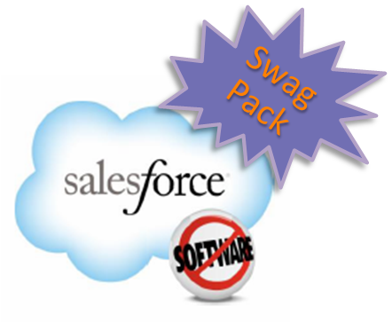
Who can help me organize?
Salesforce
Meetup.com
Promotional items
Access to speakers
Access to people (potential members)
Other Nationwide Group Leaders
We’re all connected on Chatter!

Slide 10

How can I get involved?
Start a new group in your area
Contact an existing leader for advice
Co-lead a group in your area
Leaders are always looking for help!
Help find new topics and speakers
Help with logistics
Help get the word out / boost membership!

Slide 11
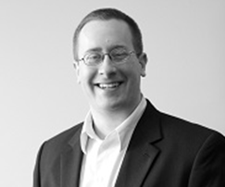
Andy Boettcher
@andyboettcher
Twin Cities Developer User Group Leader

